Slide 1


Slide 2
Lecture By Arjun Pukale

Slide 3

Logistic Regression Model
(Single Variable)

Slide 4
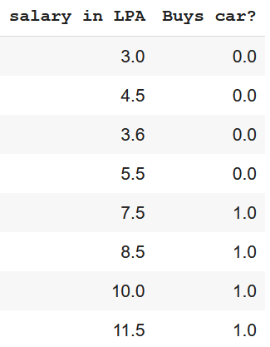
Data

Slide 5
Data
(X) (Y)
Input Feature
True Label

Slide 6
Data
(X) (Y)
Input Feature
True Label
Since Y has only 2 classes (0 and 1), it is called Binary Classification

Slide 7
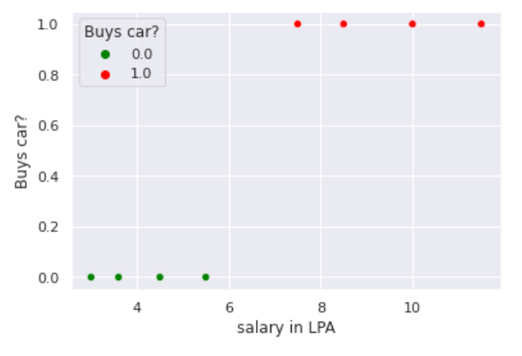
Data
(X) (Y)
Y
Input Feature
True Label
X

Slide 8
Data
Y
What Is The Task?
X

Slide 9
Data
Y
What Is The Task?
X
Classification

Slide 10
Data
Y
0 or 1?
0 or 1?
0 or 1?
What Is The Task?
X
After Training the model, given it an input ‘x’, it must tell whether this point belongs to class 1 ( y = 1) or class 0 (y = 0)
Classification

Slide 11
Data
Data
Training
input
Y
Model
0 or 1?
0 or 1?
0 or 1?
or
What Is The Task?
X
After Training the model, given it an input ‘x’, it must tell whether this point belongs to class 1 ( y = 1) or class 0 (y = 0)
Classification

Slide 12
How do we model this?
A simple step function
Y
6.5
X

Slide 13
How do we model this?
A simple step function
if x >= Threshold ,
then it belongs to class 1
if x < Threshold,
then it belongs to class 0
Y
Threshold
6.5
X

Slide 14
How do we model this?
A simple step function
if x >= Threshold ,
then it belongs to class 1
if x < Threshold,
then it belongs to class 0
Y
Is there any problem?
Threshold
6.5
X

Slide 15
How do we model this?
A simple step function
if x >= Threshold ,
then it belongs to class 1
if x < Threshold,
then it belongs to class 0
Y
Is there any problem?
Threshold
6.5
X
According to this model,
A person with a salary of 6.49 will not buy a car
A person with a salary of 6.51 will buy a car

Slide 16

How do we model this?
A simple step function
if x >= Threshold ,
then it belongs to class 1
if x < Threshold,
then it belongs to class 0
Y
Is there any problem?
Threshold
6.5
X
So Unreal !!!
According to this model,
A person with a salary of 6.49 will not buy a car
A person with a salary of 6.51 will buy a car

Slide 17
How do we model this?
A simple step function
if x >= Threshold ,
then it belongs to class 1
if x < Threshold,
then it belongs to class 0
Y
Is there any problem?
Threshold
Harsh transition
Non Differentiable
Can’t use gradient descent
6.5
X
So Unreal !!!
According to this model,
A person with a salary of 6.49 will not buy a car
A person with a salary of 6.51 will buy a car

Slide 18
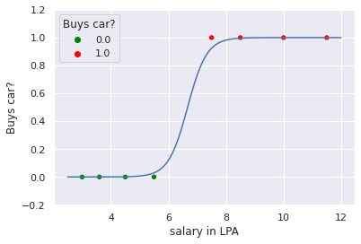
How do we model this?
A simple step function
if x >= Threshold ,
then it belongs to class 1
if x < Threshold,
then it belongs to class 0
Y
We need a smooth model !
Is there any problem?
Threshold
Harsh transition
Non Differentiable
Can’t use gradient descent
6.5
X
So Unreal !!!
According to this model,
A person with a salary of 6.49 will not buy a car
A person with a salary of 6.51 will buy a car

Slide 19
How do we model this?
A simple step function
if x >= Threshold ,
then it belongs to class 1
if x < Threshold,
then it belongs to class 0
Y
It’s called Sigmoid Function
Is there any problem?
Threshold
Harsh transition
Non Differentiable
Can’t use gradient descent
6.5
X
So Unreal !!!
According to this model,
A person with a salary of 6.49 will not buy a car
A person with a salary of 6.51 will buy a car

Slide 20

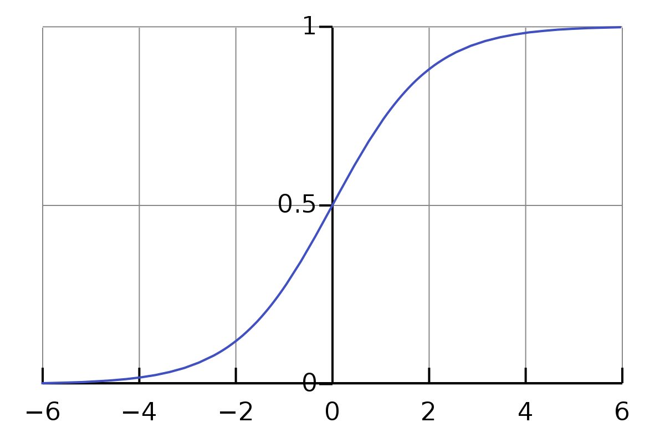
Lets understand this Sigmoid Function
Sigmoid Function
Step Function
Sigmoid Function

Slide 21
Lets understand this Sigmoid Function
Sigmoid Function
Some Properties:
Takes any real-valued input,
and outputs a value between 0 and 1.
Output can be interpreted as probability.
Y = 0.5 at z = 0 (Threshold)
Smooth transition
Differentiable
Can use gradient descent
Step Function
Sigmoid Function

Slide 22
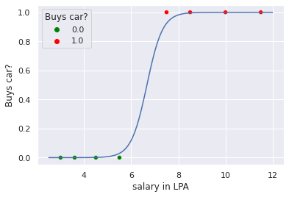


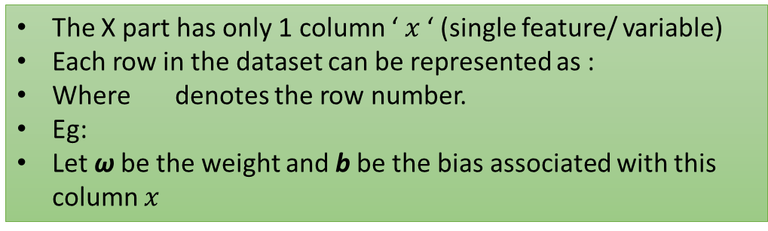
Data
X Y
The X part has only 1 column ‘ $x$ ‘ (single feature/ variable)
Each row in the dataset can be represented as :
Where denotes the row number.
Eg:
Let ω be the weight and b be the bias associated with this column $x$

Slide 23


Data
Let g be the sigmoid function given by:
Let be the prediction on input
X Y
The X part has only 1 column ‘ $x$ ‘ (single feature/ variable)
Each row in the dataset can be represented as :
Where denotes the row number.
Eg:
Let ω be the weight and b be the bias associated with this column $x$

Slide 24



Data
Let g be the sigmoid function given by:
Let be the prediction on input
X Y
Lets say ω = 3 , b = -20
The X part has only 1 column ‘ $x$ ‘ (single feature/ variable)
Each row in the dataset can be represented as :
Where denotes the row number.
Eg:
Let ω be the weight and b be the bias associated with this column $x$
For i = 5,
= 0.9241
Means, 92.41% probability of user buying the car
Or 7.59% probability of user not buying the car

Slide 25



Data
Let g be the sigmoid function given by:
Let be the prediction on input
X Y
Lets say ω = 3 , b = -20
The X part has only 1 column ‘ $x$ ‘ (single feature/ variable)
Each row in the dataset can be represented as :
Where denotes the row number.
Eg:
Let ω be the weight and b be the bias associated with this column $x$
For $x=6.0 ,$
Means, 12% probability of user buying the car
Or 88% probability of user not buying the car

Slide 26


Threshold Point
$$z$$
, when z = 0

Slide 27

Threshold Point
, when $\left(wx+b\right)=0$
$$z$$
, when z = 0

Slide 28

Threshold Point
, when $\left(wx+b\right)=0$
$$z$$
On solving the eqn:
Threshold Point
, when z = 0

Slide 29



